Slide 1

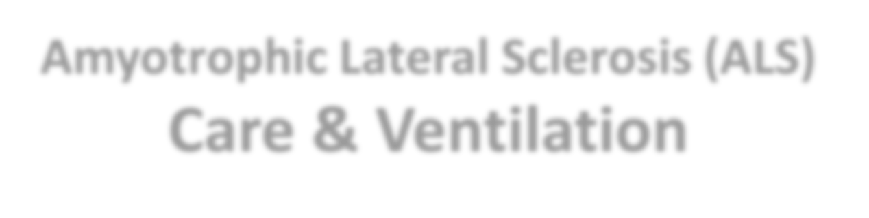
Amyotrophic Lateral Sclerosis (ALS)
Care & Ventilation
Author: Institution: Date:

Slide 2

What is ASL?
ASL is a progressive condition whereby an individual loses nerves that control movement (Radunovic et al., 2017).
The cause of ALS is unknown but some evidence point to genetics.
Specific risks that accelerate it include age, environmental toxin exposure,
smoking, age, and military service (Mayo Clinic, 2021).

Slide 3

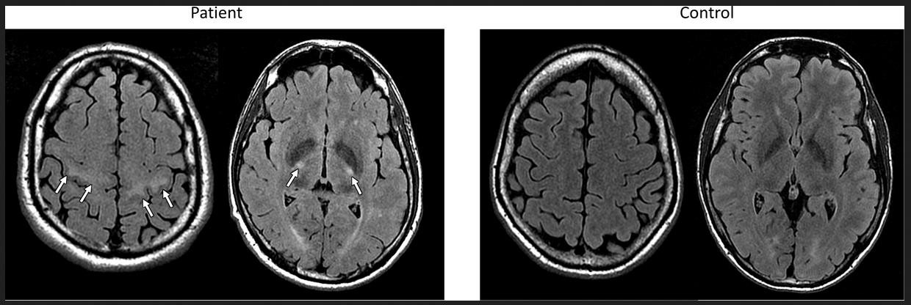
MRI Scan image of ASL
The manifestation of ASL through hyper intensity on an MRI scan
Source: Mazon et al., (2018)

Slide 4


Key Statistics about ASL
Prevalence in US
6,000: Number of Americans diagnosed
with ASL annually.
30,000: Number of Americans with ASLO
today
Common Demographic
▸ 40-70 year olds
Post-diagnosis survival rates
20%: Live for up to 5 years.
10%: Live for up to 10 years.
Data Source: ASL Association cited by Hanlon (2017)

Slide 5

Common Signs & Symptoms
General Symptoms
Symptoms due to muscle
respiratory failure:
▸ Supine dyspnea
▸ Fatigue
▸ Dyspnea with mild exertion
▸ Depression
▸ Weight loss
▸ Insomnia.
(Gilani et al., 2021)
▸ Difficulties in walking
▸ Weaknesses in legs and hands
▸ Tripping and falling
▸ Slurred speech
▸ Difficulty in swallowing food
▸ Muscle cramps, and twitching
▸ Minimal or no pain experienced among
patients.
(Mayo Clinic, 2021)

Slide 6
▸ No, there are no known treatment for the disease with regular medications to manage the conditions.
Is ASL
Treatable?

Slide 7


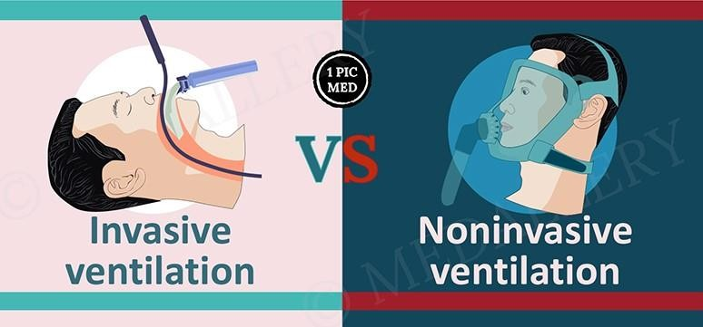
Ventilation Approaches

Slide 8
Mechanically assisted invasive ventilation (MAIV)
▸ It is less recommended because of the life-threatening complications
associated with it.
▸ Some of the risks associated with MAIV include alveolar damage, injury to the airways, ventilator-associated pneumonia, and tracheobronchitis (Brochard, 2003; Pinto, 2013).
▸ A more in-depth evaluation is required to ascertain its effectiveness in the
care of patients with ASL.

Slide 9
Non-invasive Ventilation (NIV)
▸ Elongates the patient's survival and ensure better quality of life (Radunovic
et al., 2017).
▸ Longer patient survival and quality of life but dependent on how best
ventilation and adherence are optimized (O'Brien et al., 2019).
▸ Effective in compensating for diaphragm weakness, alleviating hypercapnic symptoms, and enhancing general conditions of wellness (Dorst and Ludolph, 2019).
▸ Recommended: Safer and lesser risks to patients with ASL.

Slide 10
References
Brochard, L. (2003). Mechanical ventilation: invasive versus noninvasive. European Respiratory Journal, 22, 31-37 DOI:
10.1183/09031936.03.00050403
Dorst, J., & Ludolph, A. C. (2019). Non-invasive ventilation in amyotrophic lateral sclerosis. Therapeutic advances in neurological disorders, 12, 1756286419857040. Doi: 10.1177/1756286419857040
Gilani, A., Hinn, A., & Jacobson, P. (2021). Management of Respiratory Failure in ALS. Palliative care Network of Wisconsin. Retrieved on 21 February
2021 from https://www.mypcnow.org/fast-fact/management-of-respiratory-failure-in-als/
Hanlon, P. (2019). ALS Care and Ventilation. RT Magazine. Retrieved on 21 February 2021 from https://rtmagazine.com/department- management/clinical/als-care-ventilation/
Mayo Clinic (2021). Amyotrophic lateral sclerosis (ALS). Retrieved on 21 February 2021 from https://www.mayoclinic.org/diseases-
conditions/amyotrophic-lateral-sclerosis/symptoms-causes/syc-20354022
Mazón M, Vázquez Costa JF, Ten-Esteve A and Martí-Bonmatí, L. (2018). Imaging Biomarkers for the Diagnosis and Prognosis of Neurodegenerative
Diseases. The Example of Amyotrophic Lateral Sclerosis. Front. Neurosci. 12,784-98. Doi: 10.3389/fnins.2018.00784
O’Brien, D., Stavroulakis, T., Baxter, S., Norman, P., Bianchi, S., Elliott, M., & McDermott, C. (2019). The optimization of non-invasive ventilation in amyotrophic lateral sclerosis: A systematic review. European Respiratory Journal, 1900261. Doi:10.1183/13993003.00261-2019
Pinto, A. C. (2013). Mechanically Assisted Invasive Ventilation for ALS patients: Is it the Ultimate Strategy to Improve Survival? Revista Portuguesa de Pneumologia, 19(4), 184–185. doi:10.1016/j.rppneu.2013.06.003
Radunovic, A., Annane, D., Rafiq, K., Brassington, R., and Mustfa N. (2017). Mechanical ventilation for amyotrophic lateral sclerosis/motor neuron
disease. Cochrane Database of Systematic Reviews, Issue 10. Art. No.: CD004427. DOI: 10.1002/14651858.CD004427.pub4.
Sancho, J., Servera, E., Díaz, L., et al. (2011). Home tracheotomy mechanical ventilation in patients with amyotrophic lateral sclerosis: causes,
complications and 1-year survival. Thorax, 66, 948-952.
•
•
•
•
•
•
•
•
•

